Slide 1
Children vs Adults
Age Recognition

Slide 2
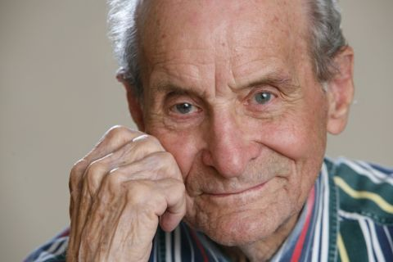
Is MichaEl a Child or an Adult?

Slide 3
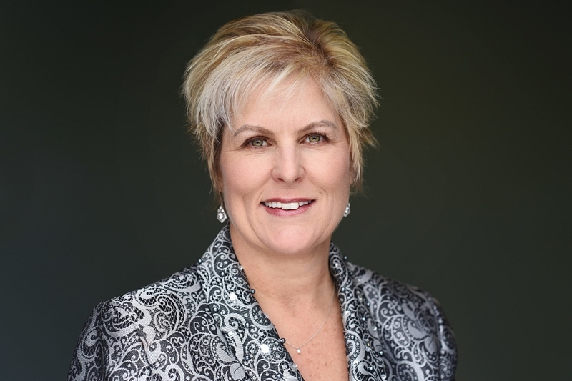
Is Monica a child or an Adult?

Slide 4
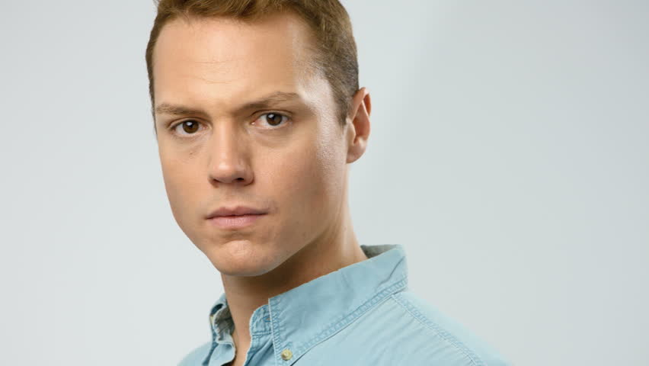
Is David a Child or AN Adult?

Slide 5
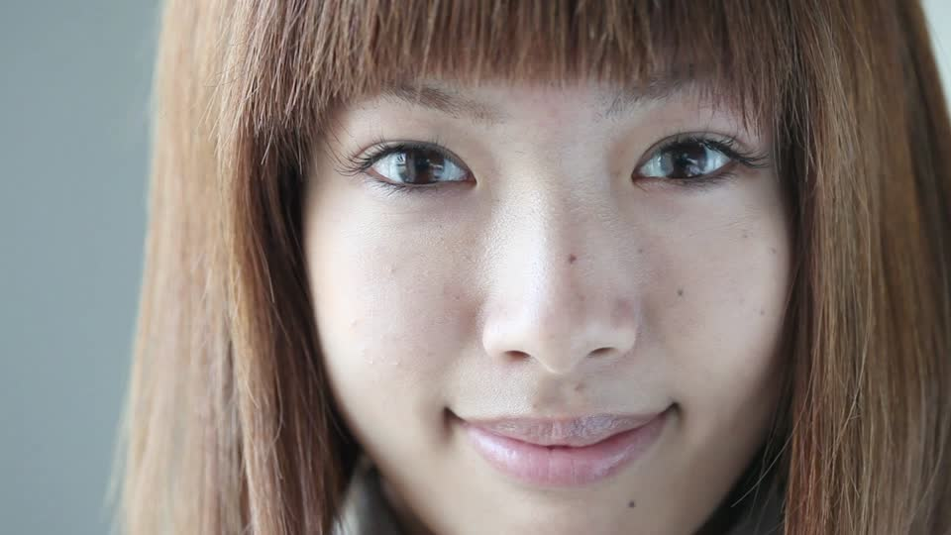
Is Jackie a child or an adult?

Slide 6
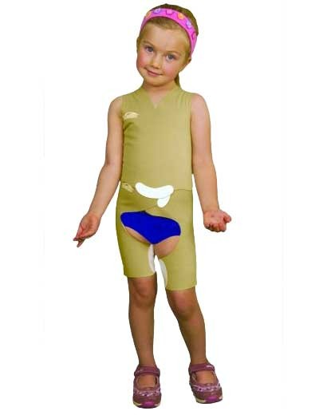
Is Sarah a Child or an Adult?

Slide 7
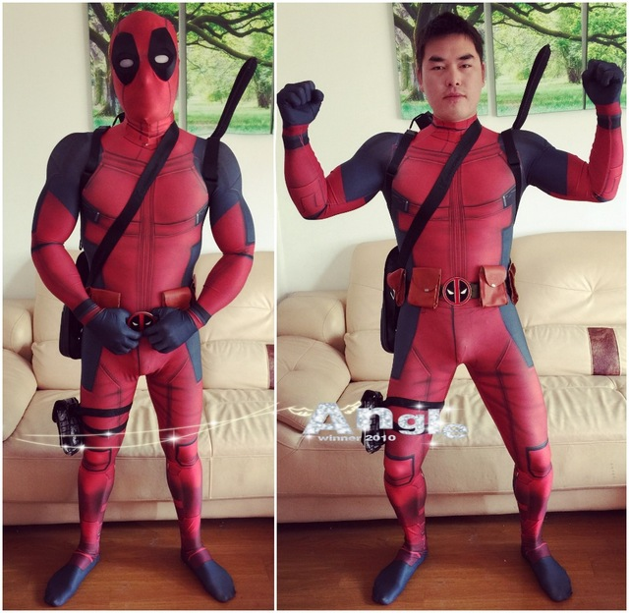
Is John A child or an adult?

Slide 8
Is Jennifer a Child or an adult?

Slide 9
Is Jacob a Child or an Adult?

Slide 10
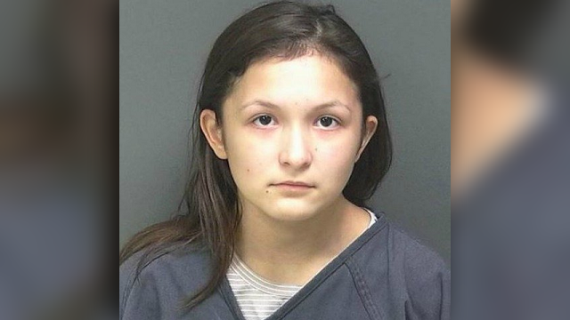
Is Lisa a child or an adult?

Slide 11
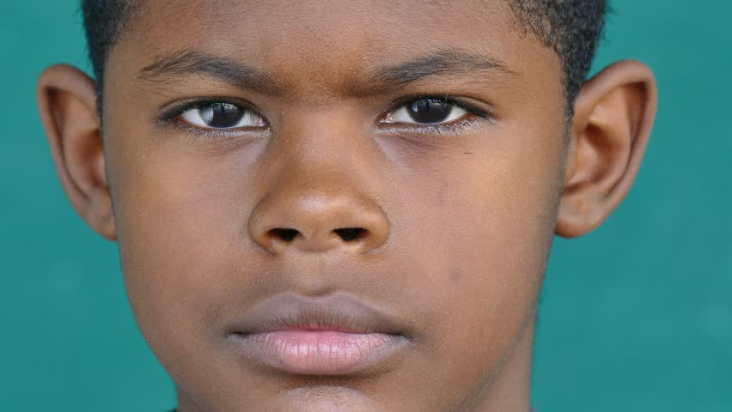
Is Charles a child or an Adult?

Slide 12
Is Mary a Child or an Adult?

Slide 13
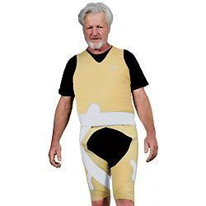
Is Gary a Child or an adult?

Slide 14
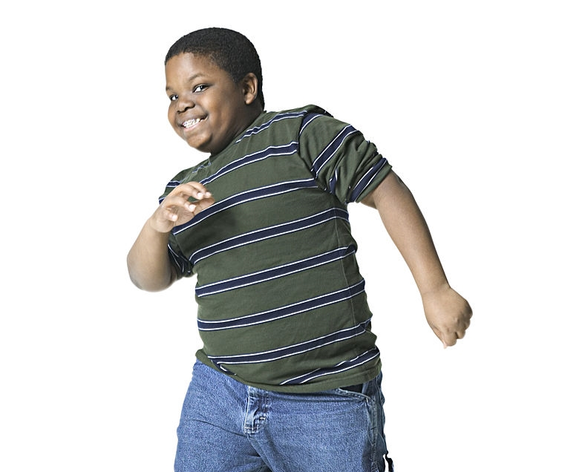
Is Kevin a child or an adult?

Slide 15
Is Adam a Child Or an Adult?

